Slide 1
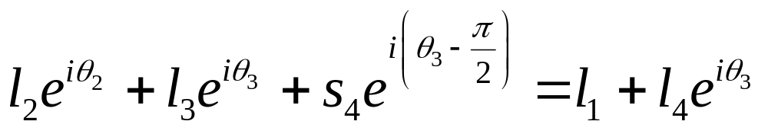
Position Analysis of a RRPR Inverted Slider Crank (Oscillating Slider) Using Complex Numbers
Q
l₅
Im
θ₅
l₃
θ₃
l=s₄
l₂
P
θ₂
l₄
θ₄
O
Re
l₁
Viewing the point P from two directions in the complex plane
Note that e = l₄ –l₃, l = s₄ and θ₃ = θ₄

Slide 2


Position Analysis of a RRPR Inverted Slider Crank (Oscillating Slider) Using Complex Numbers
Q
l₅
Im
θ₅
l₃
θ₃
l=s₄
l₂
P
θ₂
l₄
θ₄
O
Re
l₁
Separating the real
And the imaginary parts
We have two unknowns
And two scalar equations to solve for them

Slide 3
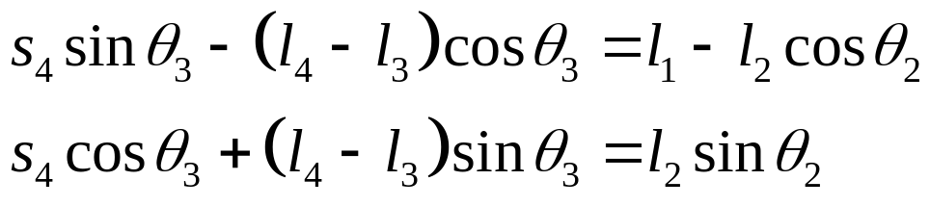
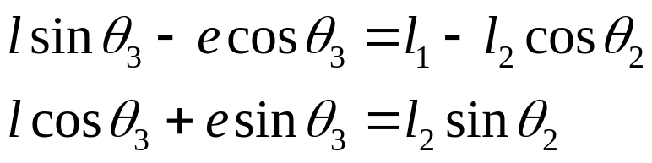
Position Analysis of a RRPR Inverted Slider Crank (Oscillating Slider) Using Complex Numbers
Q
l₅
Im
θ₅
l₃
θ₃
l=s₄
l₂
P
θ₂
l₄
θ₄
O
Re
l₁
Rearranging terms
Introducing new variables

Slide 4
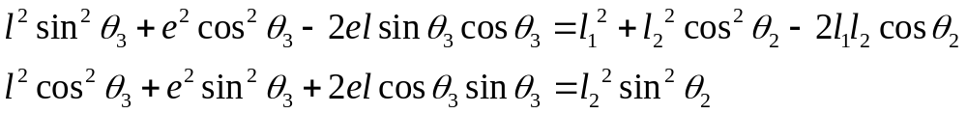
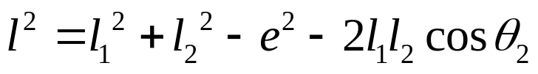
Position Analysis of a RRPR Inverted Slider Crank (Oscillating Slider) Using Complex Numbers
Q
l₅
Im
θ₅
l₃
θ₃
l=s₄
l₂
P
θ₂
l₄
θ₄
O
Re
l₁
Squaring , adding and rearranging
Adding and rearranging

Slide 5
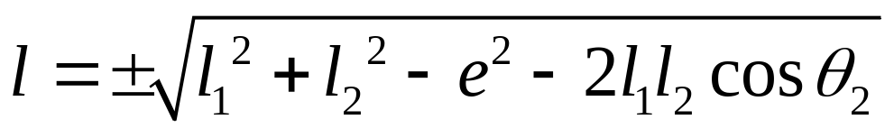
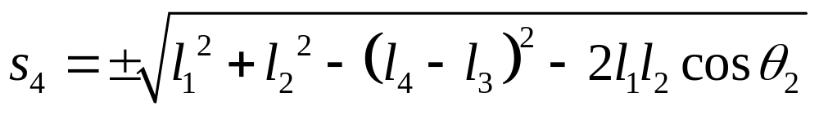
Position Analysis of a RRPR Inverted Slider Crank (Oscillating Slider) Using Complex Numbers
Q
l₅
Im
θ₅
l₃
θ₃
l=s₄
l₂
P
θ₂
l₄
θ₄
O
Re
l₁
Expanding and rearranging we get two roots
In terms of the original variables

Slide 6
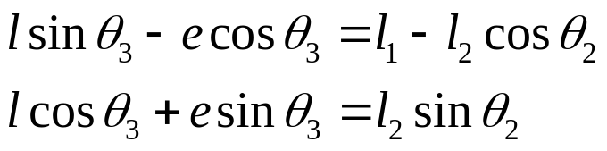
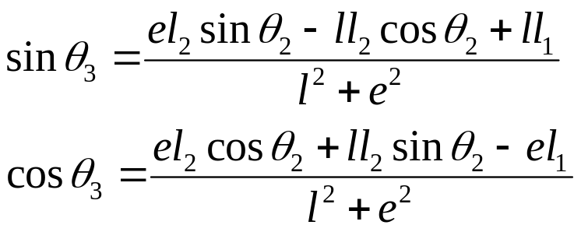
Position Analysis of a RRPR Inverted Slider Crank (Oscillating Slider) Using Complex Numbers
Q
l₅
Im
θ₅
l₃
θ₃
l=s₄
l₂
P
θ₂
l₄
θ₄
O
Re
l₁
We already have
We can get
The signs of sinθ₃ and cosθ₃ will let us determine the quadrant in which θ₃ lies

